Slide 1
INB255/INN255 Security
Lecture 3:
Privacy and Security

Slide 2
Outline
What is privacy?
Protecting privacy
Legislation
Threats to privacy
People
Technology
Identity Theft
Summary

Slide 3
What is privacy?
Definition:
“A state in which one is not observed or disturbed by other people, the state of being free from public attention”
Oxford dictionary
Involves separating the individual
or things concerning the individual, regarded as personal
from others: the public

Slide 4
What is privacy?
Definition:
“the interest that individuals have in sustaining a 'personal space', free from interference by other people and organisations”
Roger Clarke
member of the Australian Privacy Foundation
http://www.rogerclarke.com/DV/Intro.html

Slide 5
What is privacy?
Specific meaning depends on context – Clarke’s four dimensions of privacy:
Privacy of the person
Physical or bodily privacy: about the integrity of the body and consent to physical procedures
Privacy of personal behaviour
Including political, religious and sexual practices and preferences
Privacy of personal communications
Being able to communicate with other individuals without routine monitoring by others
Privacy of personal data
Control over personal data and how it will be used, even when it is held by another organisation

Slide 6
What is privacy?
For information security we consider privacy of:
Personal communications
Are your communications monitored by other people or organisations?
Who, how, why?
Personal data
Are your personal details available to others?
Who, how, why?
Should other people/organisations have access to your personal information?
Ongoing debate about public interest v’s individual rights

Slide 7
Outline
What is privacy?
Protecting privacy
Legislation
Threats to privacy
People
Technology
Identity Theft
Summary

Slide 8
Protecting privacy
Question: Do I have a right to privacy?
That is, is my privacy protected by law?
Laws are rules that mandate or prohibit certain behaviours in society:
Carry the sanctions of a governing authority
Direct goal of laws is not preventing the behaviours - it is punishing misbehaviour after the fact
Indirect goal may be preventing misbehaviour
using the prospect of punishment as a deterrent

Slide 9
Protecting privacy
Question: Do I have a right to privacy?
Answer:
In Australia, there is specific privacy legislation:
At the federal level (Commonwealth of Australia)
Commonwealth Privacy Act 1988
Privacy Amendment (Private Sector) Act 2000
Privacy Amendment (Enhancing Privacy Protection) Act 2012
Comes into force on 12 March 2014
At the state level (State of Queensland)
Information Privacy Act 2009 (Qld)

Slide 10
Protecting privacy
Australian legal system:
Similar to British:
Statute law – legislation enacted by parliaments
Common law – based on court judgements handed down in previous cases
Legislation at both Federal and State levels:
(Australia is a federation of 6 states and 2 territories)
Commonwealth of Australia has (federal) legislation, and
Each state has own state legislation
Two types of law:
Criminal law – action taken by government against individual or organization
Civil law – action taken by individuals or organizations

Slide 11
Protecting privacy
Commonwealth Privacy Act 1988
Deals with privacy of personal information
Personal information defined as information that identifies you, or could identify you
Examples:
Name, address, date of birth, medical records, bank account details,
Regulates how your personal information can be collected, used, and disclosed, and how it should be maintained
Provides ‘principles’ rather than instructions for implementation

Slide 12
Protecting privacy
Commonwealth Privacy Act 1988
Objectives: protection of personal information and tax file numbers held by federal and ACT government departments and agencies
Act defines personal information as:
"... information or an opinion (including information or an opinion forming part of a database), whether true or not, and whether recorded in a material form or not, about an individual whose identity is apparent, or can reasonably be ascertained, from the information or opinion."
Notes:
Office of Australian Information Commissioner provides links to Privacy information, including legislation:
http://www.privacy.gov.au/government

Slide 13
Protecting privacy
Commonwealth Privacy Act 1988
Act applies to:
Commonwealth and ACT government agencies
Act does not apply to:
State or Northern Territory government agencies
Non-government organisations
Commonwealth and ACT gov’t agencies must comply with:
11 Information Privacy Principles (Section 14)
Tax file number guidelines (Section 17)
Notes:
Federal Privacy commissioner’s office:
http://www.privacy.gov.au/government/index.html
On 1 November 2010 Federal Privacy Commissioners Office integrated into the Office of the Australian Information Commissioner

Slide 14
Protecting Privacy
Lots of personal information is held by non-government organisations
Commonwealth Privacy Act 1988 did not apply to these
Privacy Amendment (Private Sector) Act 2000
Extended coverage of the Privacy Act to cover parts of the private sector
including all health service providers
Includes 10 National Privacy Principles
Similar to the 11 Information Privacy Principles in the original Privacy Act

Slide 15
Protecting Privacy
Privacy Amendment (Private Sector) Act 2000
Exemptions from the Act include:
Small business with annual turnover $3 million or less
Some conditions on this:
Can’t be subsidiary of larger business, etc
Can’t be health service provider, etc
Can’t disclose personal information to others for benefit or advantage
Can’t be a contracted service provider for Commonwealth contract
Registered political parties
And others …

Slide 16
Protecting privacy
Privacy Amendment (Enhancing Privacy Protection) Act 2012
Provides one set of principles that applies to:
Australian federal government agencies,
ACT and Norfolk Island government agencies,
Private-sector businesses with annual turnover > $3million
Private sector health service providers
Replaces:
11 Information Privacy Principles in original Privacy Act, and
10 National Privacy Principles in the 2001 Amendment with
13 Australian Privacy Principles, grouped into five parts:
Consideration of personal information privacy
Collection of personal information
Dealing with personal information
Integrity of personal information
Access to, and correction of, personal information

Slide 17
Protecting privacy
Privacy Amend (Enhancing Privacy Protection) Act 2012
Part 1: Consideration of personal information privacy
APP1 – Open and transparent management of personal information
Entities must manage personal information in an open and transparent way:
Take reasonable steps to comply with the APPs
Have a clearly expressed and up to date policy about how they manage personal information (a Privacy Policy)
Make the privacy policy available free of charge and in appropriate form
APP2 – Anonymity and pseudonymity
Individuals must have the option of not identifying themselves, or of using a pseudonym …

Slide 18
Protecting privacy
Privacy Amend (Enhancing Privacy Protection) Act 2012
Part 2: Collection of personal information
APP 3 – Collection of solicited personal information
For personal information other than sensitive information,
Must not collect unless information is reasonably necessary
For sensitive information about an individual,
Must not collect unless individual consents and info is reasonably necessary
Some exemptions to this (if required by law, permitted health situation, …)
Must collect personal information
Only by lawful and fair means
Only from the individual (some exemptions for this)

Slide 19
Protecting privacy
Privacy Amend (Enhancing Privacy Protection) Act 2012
Act defines sensitive information as a subset of personal information, as:
... information or an opinion (that is also personal information), about an individual’s:
racial or ethnic origin
political opinions
membership of a political association
religious beliefs or affiliations
philosophical beliefs
membership of a professional or trade association, or of a trade union
Sexual preferences or practices, or criminal record
Health information about an individual
Genetic information (that is not otherwise health information)
Biometric information that is to be used for the purpose of automated biometric verification or biometric identification, or
Biometric templates
Semester 1 2014
INB/INN 255 Security
19
Notes:
19
Office of Australian Information Commissioner provides links to Privacy information, including legislation:
http://www.privacy.gov.au/government

Slide 20
Protecting privacy
Privacy Amend (Enhancing Privacy Protection) Act 2012
Part 2: Collection of personal information
APP 4 – Dealing with unsolicited personal information
On receipt of unsolicited personal information, must determine whether the agency/organisation could have collected the information under APP3 if they had solicited it
Can use the information for the purposes of making this determination
If determination is:
could not have collected the information and information is not contained in a Commonwealth record, then information must be destroyed or de-identified
could have collected the information then APPs apply as if info was collected
APP 5 – Notification of the collection of personal information
Must take reasonable steps to notify individual of
Identity and contact details of agency/organisation collecting info
If collection required by law
Purposes for which information is collected
Consequences if some/all information not collected
Anyone to which personal information of the kind collected will be disclosed to
And whether it may be disclosed to overseas recipients ( & which countries)
Details of agency/organisation privacy policy

Slide 21
Protecting privacy
Privacy Amend (Enhancing Privacy Protection) Act 2012
Part 3: Dealing with personal information
APP 6 – Use or disclosure of personal information
Information collected for a particular purpose cannot be used or disclosed for another purpose, unless:
Individual consented
Reasonable expectation organisation would use the info for that purpose, …
Required by law
etc
APP 7 – Direct marketing
Must not use or disclose personal information for direct marketing
Some exceptions for personal info other than sensitive
Must be able to request not to receive direct marketing communications

Slide 22
Protecting privacy
Privacy Amend (Enhancing Privacy Protection) Act 2012
Part 3: Dealing with personal information
APP 8 – Cross-border disclosure of personal information
Before personal information is disclosed to a recipient overseas, must take reasonable steps to ensure recipient doesn’t breach APPs.
Some exemptions
APP 9 – Adoption, use or disclosure of government related identifiers
Cannot use government related identifier as own identifier, unless:
Required or authorised by law (or some regulations)
Cannot use or disclose government related identifier, unless:
Necessary for organisation functions or obligations to authority
Use required by law, etc.

Slide 23
Protecting privacy
Privacy Amend (Enhancing Privacy Protection) Act 2012
Part 4: Integrity of personal information
APP 10 – Quality of personal information
Must take reasonable steps to ensure personal information collected is accurate, up to date and complete.
Must take reasonable steps to ensure personal information used or disclosed is accurate, up to date, complete and relevant.
APP 11 – Security of personal information
Must take reasonable steps to protect the information
From misuse, interference and loss; and
From unauthorised access, modification or disclosure
Personal information no longer needed, and not required to be retained should be destroyed or de-identified

Slide 24
Protecting privacy
Privacy Amend (Enhancing Privacy Protection) Act 2012
Part 5: Access to, and correction of, personal information
APP 12 – Access to personal information
If requested by individual, must give access to the personal information held
Some exceptions (required by law to refuse, access poses a serious threat, would impact on the privacy of others, etc)
APP 13 – Correction of personal information
Must correct if personal information is inaccurate, out of date, incomplete, irrelevant or misleading
Must notify third parties of correction if info previously disclosed
If information not corrected, must give written notice of reasons, and mechanisms available to complain

Slide 25
Protecting privacy
State & Territory privacy legislation:
Most Australian States and Territories have some form of privacy legislation for government agencies, or guidelines based on the federal legislation
No specific privacy legislation in Western Australia.
Some states have legislation covering private sector agencies, but most do not.
Notes:
http://www.privacy.gov.au/privacy_rights/laws/index.html

Slide 26
Protecting privacy
Queensland:
Information Privacy Act 2009
http://www.legislation.qld.gov.au/LEGISLTN/ACTS/2009/09AC014.pdf
11 Information Privacy Principles
Controls the way all Qld government agencies handle information
Exception: Queensland Health
Nine National Privacy Principles for Qld Health information
Prior to this, Qld Government agencies had to comply with an information standard: IS42 Information Privacy
IS 42 Repealed on 1 July, 2009
Notes:
http://www.legislation.qld.gov.au/LEGISLTN/ACTS/2009/09AC014.pdf

Slide 27
Protecting privacy
Queensland:
QUT must act in accordance with the Information Privacy Act 2009 (Qld):
See MOPP, Chapter F Information Management
Section 6.2 Information Privacy
Personal information includes:
usernames, passwords, staff and student numbers
Format of recorded information includes:
hard copy documents,
electronic documents, databases,
photographs and other images,
staff/student identity cards.

Slide 28
Outline
What is privacy?
Protecting privacy
Legislation
Threats to privacy
People
Technology
Identity Theft
Summary

Slide 29
Threats to privacy
People:
Information privacy can be threatened by actions of others, including:
Friends
Employees (Information users within organisations)
Employers (Management)
Government
Others?

Slide 30
Threats to privacy
People:
Friends:
Especially in connection with social media sites: Comments, tagging in photos, etc.
Employees (Information users within organisations):
Deliberate actions: insiders misusing authority
Accidental errors: releasing personally identifiable information

Slide 31
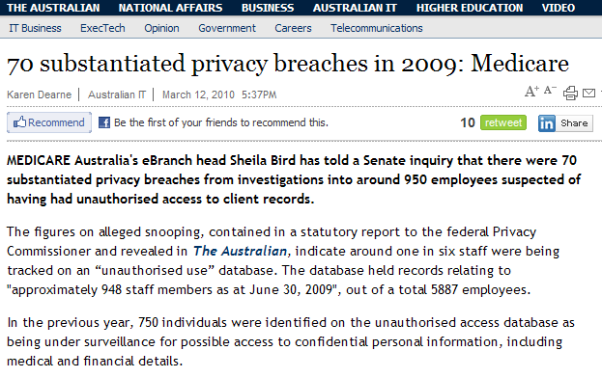
Threats to privacy
People – examples:
http://www.theaustralian.com.au/australian-it/substantiated-privacy-breaches-in-2009-medicare/story-e6frgakx-1225840159226
Notes:
Now http://www.trueactive.com/index.htm

Slide 32
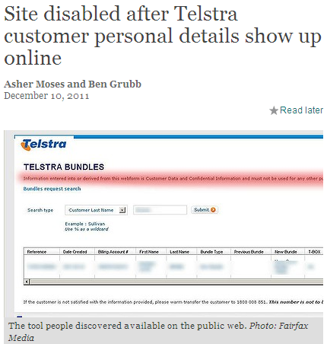
Threats to privacy
People – examples:
http://www.smh.com.au/it-pro/security-it/site-disabled-after-telstra-customer-personal-details-show-up-online-20111209-1onpd.html
Notes:
http://www.smh.com.au/it-pro/security-it/site-disabled-after-telstra-customer-personal-details-show-up-online-20111209-1onpd.html

Slide 33
Threats to privacy
People – examples:
Telstra example, continued
Information Commissioner launched investigation into privacy breach and released a report in June 2012
found Telstra breached NPP 2 & NPP 4.
Telstra investigation found breach caused by errors:
Project incorrectly categorised as one that did not involve any personal information, so initially no security controls put in place
Employees aware of breach did not inform management
When protection put in place, tool later became publically available again after a software restoration removed those protections

Slide 34
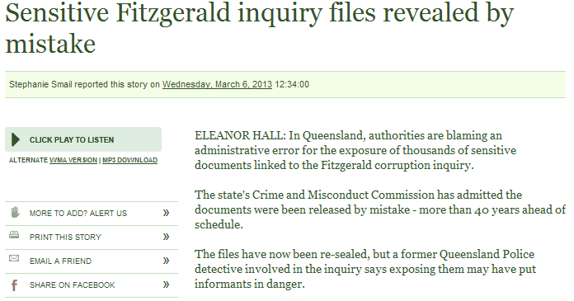
Threats to privacy
People – examples:
http://www.abc.net.au/worldtoday/content/2013/s3708279.htm

Slide 35
Threats to privacy
People:
Employers (Management):
Make policy decisions regarding monitoring actions of others
Common reasons for workplace surveillance are:
performance evaluation (employee efficiency)
compliance with federal and local laws
protection against legal liability, and
cost control of the use of company resources
For example, phone and internet
In which areas and which functions is monitoring reasonable?

Slide 36
Threats to privacy
People:
Government:
May monitor personal data and communications ‘in the national interest’
In Australia, general monitoring of telephone calls is not permitted:
Federal Telecommunications (Interception) Act 1979
Some exceptions (where law enforcement agencies have warrant)
Similar position in the US,
But mass surveillance of communications by NSA & phone companies reported (June 2013 Edward Snowden)

Slide 37
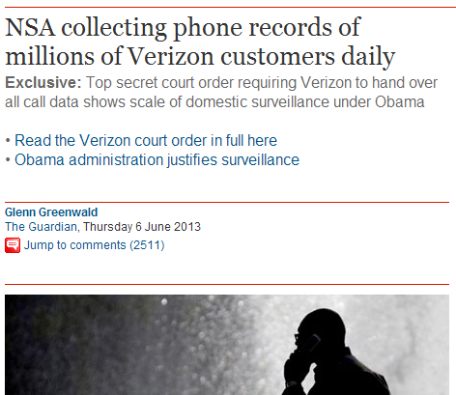
Threats to privacy
Classified documents leaked by Edward Snowden June 2013 include court order requiring Verizon to give NSA records for phone calls

Slide 38
Threats to privacy
Technology
Advances in technology make collecting and processing large amounts of information possible
Many tools that are useful for monitoring and harvesting specific personal data, including:
Monitoring phone calls – number dialled, location data, time and duration of calls
Monitoring internet access - URLs visited, time spent, site visited previously
Monitoring email - sent, recipient, content of email
Keystroke logging

Slide 39
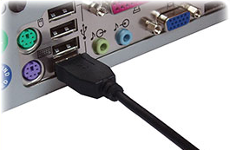
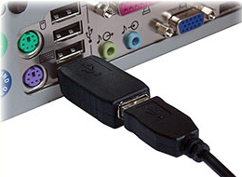
Threats to privacy
Technology examples:
Monitoring user activity – keystroke logger
Hardware:
Examples: KeyGhost, Keyshark, KeyGrabber
http://www.keelog.com/usb_hardware_keylogger.html
Models available
8M cost less than US$50 (stores 8,000,000 keystrokes)
2G cost less than US$60 (stores 2,000,000,000 keystrokes)
Notes:
http://www.keelog.com/usb_hardware_keylogger.html

Slide 40
Threats to privacy
Technology examples:
Monitoring user activity – keystroke logger
Software:
Examples: Stealth Keylogger, Spector Pro
Software products that cost less than US$100
Logged data can be
stored on computer for later retrieval, or
transmitted to remote location
Note: some trojans install software keyloggers on your PC without you or your employer’s consent, and send the information recorded to others

Slide 41
Threats to privacy
Technology examples:
Monitoring internet use: Cookies
Cookies are small text files
Initially sent from a web server to a web browser
Then from browser back to server on subsequent visits
Example:
GSPID=0e755d775574d1cescholar.google.com.au/1536271887833632111634328442790830060602*
Notes:
Try the CookieView program available at http://www.digital-detective.co.uk/freetools/cookieview.asp

Slide 42
Threats to privacy
Technology examples:
Monitoring internet use: Cookies
Can be used to store personal information or unique identifying fields
Example: login name, shopping cart information, location information
Are used
to keep ‘state’ when browsing different pages on a site
to ‘personalise’ web sites to correspond to user preferences
Example: a weather site may show the forecast just for your geographical area
Notes:
Try the CookieView program available at http://www.digital-detective.co.uk/freetools/cookieview.asp

Slide 43
Threats to privacy
Technology examples:
Monitoring internet use: Cookies
Cookies can be
persistent (stored on browser machine hard drive) or
non-persistent (in memory for that particular session only)
Persistent cookies can be set to be valid for many years
Users may disable cookies, although some services will be degraded
Some applications set cookies that actively resist deletion: ‘evercookies’

Slide 44
Threats to privacy
Technology examples:
Monitoring internet use: Cookies
Third party advertising providers also use cookies:
to ‘target’ ads (send you ads for things you are likely to be interested in)
to serve different ads to the same user (rather than repeating the same ad)
to measure
how many unique users see a particular ad, and
from which web site the ad was seen

Slide 45
Threats to privacy
Technology examples:
Monitoring internet use: Cookies
When multiple sites use the same banner-ad providers, cookies can be used to track browsing behaviour
Example: doubleclick.net (now owned by Google)
Cookies can also be read by websites other than the ones that set them
This can lead to profiling of a person’s interests and on-line behaviour
without their knowledge or consent
Notes:
If you use internet explorer, see Microsoft’s Description of cookies at http://support.microsoft.com/kb/260971

Slide 46
Threats to privacy
Technology examples:
Monitoring internet use: Cookies
Opt-out versus opt-in
Most 3rd party advertising providers make provision for people to ‘opt-out’ of being tracked by cookies
By default you are already ‘in’
You can choose to opt-out
BUT
you have to know it exists before you can choose not to participate!

Slide 47
Threats to privacy
Technology examples:
Monitoring internet use: Web bugs
(Also called web beacons, page tags, pixel tags …)
Used to keep track of which users view web pages or read email messages, and when
Do this by including content
such as a graphic (the bug)
that must be retrieved from another server to construct the page or message
Could be single pixel, or small company image
For the message or page to be displayed, a request is sent to this server
Request includes details such as IP address of requesting computer, time of request, type of web browser
Notes:
See http://w2.eff.org/Privacy/Marketing/web_bug.html

Slide 48
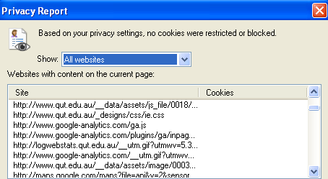
Threats to privacy
Technology examples:
Monitoring internet use: Web bugs
When viewing a web page, check out where the content of the page is from:
Using Safari choose: Develop -> Web Inspector -> Resources -> Images
Using MS-IE choose: View -> Webpage Privacy Policy

Slide 49
Threats to privacy
Semester 1 2014
Many organizations have a business need for your personal information:
Huge volumes of data collected
Can be stored for long periods of time
To use, may employ ‘data mining’:
“a set of automated techniques used to extract buried or previously unknown pieces of information from large databases”
Can be used to:
Identify particular sets of actions
Find general patterns of behaviour
Profile individual customers
Notes:
49

Slide 50
Threats to privacy
INB/INN 255 Security
50
Technology example: data mining
Commercial organisations and data mining:
Could be used:
to develop marketing strategies by extracting consumer behaviour, demographic, economic and geographic information
for public health studies
to detect fraud (both govt. agencies and credit card companies)
to correlate disparate data in law enforcement investigations
Deposits/withdrawals from bank accounts
Purchases using cards
Entry/exit at international ports
Data mining can be used to correlate ‘anonymous’ activities and identify individuals
Notes:
50
http://www.spss.com/

Slide 51
Threats to privacy
INB/INN 255 Security
51
Technology example: data mining
Commercial organisations and data mining:
Used to develop a detailed profile of an individual’s
interests
movements
economic status and
demographics
Process is largely invisible for consumers
Lots of small pieces of personal information can add up to much more detail than a person is comfortable disclosing
Individuals may feel that it violates their privacy

Slide 52
Threats to privacy
Technology examples:
Check the privacy policy for organisations you are providing information to. For example: Google http://www.google.com.au/intl/en/policies/privacy/
“We collect information in two ways:
Information you give us … name, email address, telephone number or credit card …
Information we get from your use of our services …
We use information collected from cookies and other technologies, like pixel tags, to improve your user experience …
We may combine personal information from one service with information, including personal information, from other Google services – for example to make it easier to share things with people you know. We will not combine DoubleClick cookie information with personally identifiable information unless we have your opt-in consent.
We will ask for your consent before using information for a purpose other than those that are set out in this Privacy Policy”
52
Notes:
52

Slide 53
Outline
What is privacy?
Protecting privacy
Legislation
Threats to privacy
People
Technology
Identity Theft
Summary

Slide 54
Identity Theft
A crime where one person uses another person’s key personal information to fraudulently impersonate them
The imposter uses this for their own benefit:
Obtain advantages that the victim has:
Examples: access to certain locations or services, get loans, credit cards, drivers license, rental accommodation, medical care, etc
Avoid penalties incurred by their actions
Example: failing to make loan repayments or pay credit card bills, using victim’s ID if caught speeding or other infringement, etc
Notes:
http://www.idtheftcenter.org/index.html
A good example of how identity theft can effect the victim:
http://www.msnbc.com/news/877978.asp?0si=-&cp1=1
http://www.symantec.com.au/region/au_nz/homecomputing/library/theft.html

Slide 55
Identity Theft
Information used to steal someone’s identity can be gained by:
‘Dumpster diving’ (digging through rubbish bin contents)
for paper items that reveal personal information: credit card receipts, pre-approved credit forms, etc
Raiding letterboxes:
Mail may include unique identifiers such as Tax File Number
Social engineering
Phone calls, email messages, phishing scams, etc
Obtaining credit reports on victims
Notes:
http://www.smh.com.au/articles/2003/08/18/1061059762804.html
http://www.zdnet.com.au/newstech/security/story/0,2000048600,20276155,00.htm
http://www.cbc.ca/stories/2004/03/16/credittheft040316
http://www.identitytheft.org/

Slide 56
Identity Theft
Information used to steal someone’s identity can often be gained using online resources:
Personal information from public sources:
Personal web page, social networking sites
Sites that are public, but should not be:
December 2011 Telstra customer database example
March 2009 Qld pathology lab breach details of > 100 patients
Lists of credit card numbers available online (free & for sale)
Using malware to compromise a user’s PC
trojan keystroke logger
Attacking databases holding personal information
Notes:
http://www.smh.com.au/articles/2003/08/18/1061059762804.html
http://www.zdnet.com.au/newstech/security/story/0,2000048600,20276155,00.htm
http://www.cbc.ca/stories/2004/03/16/credittheft040316
http://www.identitytheft.org/

Slide 57
Identity Theft
Victim may not be aware that identity theft has occurred:
May not be aware of unauthorised use until bank statement/bill/ fine is delivered
Check your bank statements to make sure all transactions are yours
Attacker may alter address for statements, bills, so victim remains unaware of compromise
Check your records at set intervals, even if not issued frequently by supplier
Not sure if that interesting email offer is a phishing scam?
Check SCAMWatch: http://www.scamwatch.gov.au/content/index.phtml/tag/Scamwatch/
INB/INN 255 Security
57
Notes:
57

Slide 58
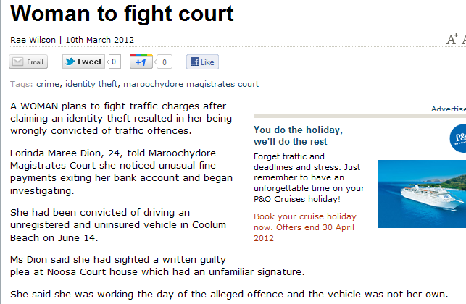
Identity Theft
Example:
http://www.sunshinecoastdaily.com.au/story/2012/03/10/woman-to-fight-maroochydore-court/
INB/INN 255 Security
58
Notes:
58

Slide 59
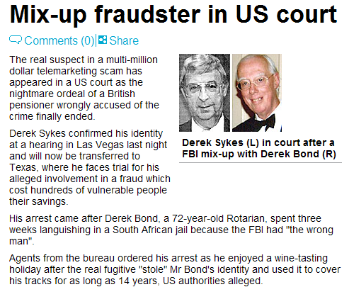
Identity Theft
Example: February 2003
http://www.dailymail.co.uk/news/article-167337/Mix-fraudster-US-court.html
INB/INN 255 Security
59
Notes:
59

Slide 60
Identity Theft
Identity theft statistics:
ABS report: Personal Fraud Survey 2010-2011
In the 12 months prior to the survey, over 4% of respondents were victims of identity fraud
(was 3.1% in 2007 Personal Fraud Survey)
Bank or credit card fraud 3.7% (2.4% in 2007)
Identity theft 0.3% (0.8% in 2007)
http://www.abs.gov.au/ausstats/abs@.nsf/Lookup/65767D57E11FC149CA2579E40012057F?opendocument
http://www.ausstats.abs.gov.au/ausstats/subscriber.nsf/0/866E0EF22EFC4608CA2574740015D234/$File/45280_2007.pdf

Slide 61
Identity Theft
Identity theft statistics:
Australian Institute of Criminology report: Trends and Issues in Crime and Criminal Justice
February 2011
Cost of fraud perpetrated on Australian issued credit/charge and debit cards in 2009
Over $170 million
ABS report: Personal Fraud Survey 2010-2011
Australians lost $1.4 billion due to personal fraud

Slide 62
Identity Theft
You may become a victim of identity theft if an organisation storing your personal data is breached
Will you know if such a breach has occurred?
and your personal data has potentially been revealed?
In the US there is legislation requiring notification
No such legislation in Australia
If you know an organisation covered by the Privacy Act has mishandled your information:
you can make a complaint to the Australian Privacy Commissioner
But how would you know this has occurred?

Slide 63
Summary
Information is important business asset
Includes personal data which can be used to identify individuals
In Australia, privacy legislation covers how personal information
is collected, used, and how it may be disclosed
is kept securely
can be accessed
Organisations have obligation to comply
People and technology impact on information privacy

